Slide 1
Computer Networks CS 3001 (BCS-5B) Lecture 5
Danyal Farhat
FAST School of Computing
NUCES Lahore

Slide 2
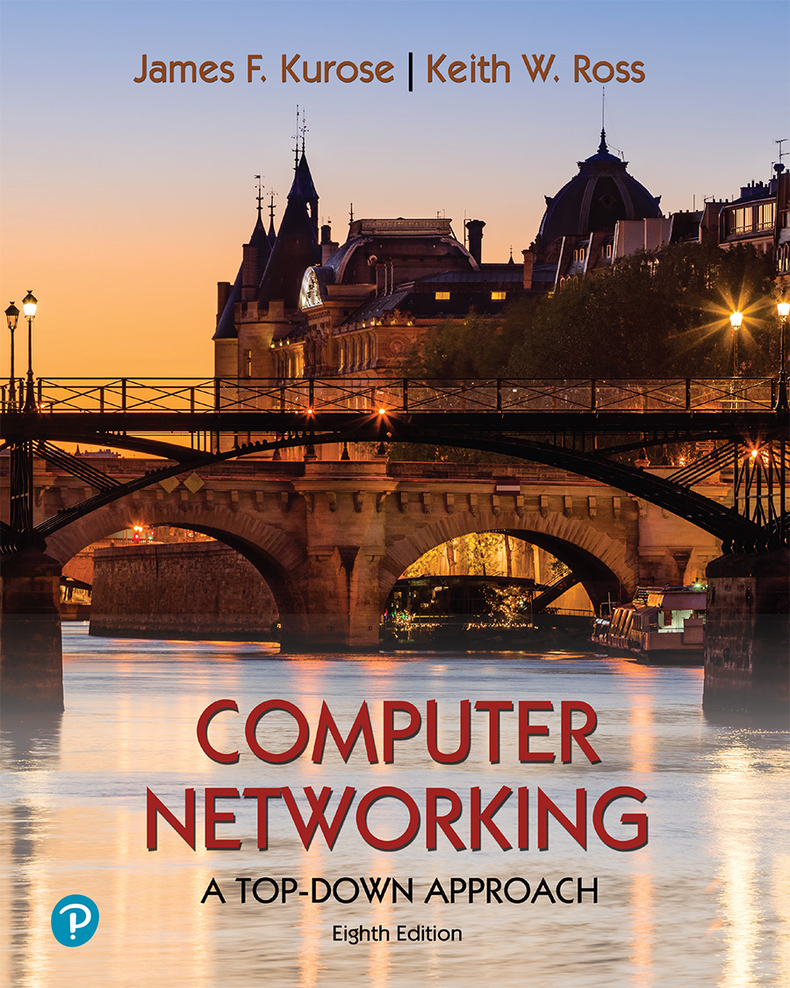
Chapter 5 Network Layer:
Control Plane
A note on the use of these PowerPoint slides:
We’re making these slides freely available to all (faculty, students, readers). They’re in PowerPoint form so you see the animations; and can add, modify, and delete slides (including this one) and slide content to suit your needs. They obviously represent a lot of work on our part. In return for use, we only ask the following:
If you use these slides (e.g., in a class) that you mention their source (after all, we’d like people to use our book!)
If you post any slides on a www site, that you note that they are adapted from (or perhaps identical to) our slides, and note our copyright of this material.
For a revision history, see the slide note for this page.
Thanks and enjoy! JFK/KWR
All material copyright 1996-2023
J.F Kurose and K.W. Ross, All Rights Reserved
Computer Networking: A Top-Down Approach 8th edition Jim Kurose, Keith Ross Pearson, 2020

Slide 3

Network layer: “control plane” roadmap
introduction
routing protocols
intra-ISP routing: OSPF
routing among ISPs: BGP
SDN control plane
Internet Control Message Protocol

Slide 4
Software Defined Networking (SDN)
Internet network layer: historically implemented via distributed, per-router control approach:
monolithic router contains switching hardware, runs proprietary implementation of Internet standard protocols (IP, RIP, IS-IS, OSPF, BGP) in proprietary router OS (e.g., Cisco IOS)
different “middleboxes” for different network layer functions: firewalls, load balancers, NAT boxes, ..
~2005: renewed interest in rethinking network control plane

Slide 5

Per-router control plane
Individual routing algorithm components in each and every router interact in the control plane to computer forwarding tables
Routing
Algorithm
control
plane
data
plane
values in arriving
packet header
0111
1
3
2

Slide 6
Software-Defined Networking (SDN) control plane
Remote controller computes, installs forwarding tables in routers
Remote Controller
control
plane
data
plane
CA
CA
CA
CA
CA
values in arriving
packet header
0111
1
3
2

Slide 7
Software defined networking (SDN)
Why a logically centralized control plane?
easier network management: avoid router misconfigurations, greater flexibility of traffic flows
table-based forwarding (recall OpenFlow API) allows “programming” routers
centralized “programming” easier: compute tables centrally and distribute
distributed “programming” more difficult: compute tables as result of distributed algorithm (protocol) implemented in each-and-every router
open (non-proprietary) implementation of control plane
foster innovation: let 1000 flowers bloom

Slide 8
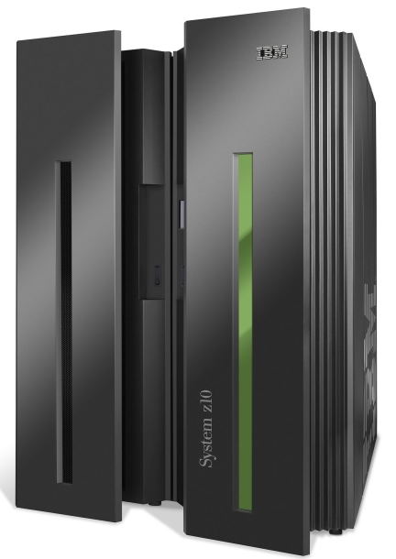




SDN analogy: mainframe to PC revolution
App
App
App
App
App
App
App
App
App
App
App
Specialized
Applications
Open Interface
Specialized
Operating
System
or
or
Windows
Linux
MAC OS
Specialized
Hardware
Open Interface
Microprocessor
Vertically integrated
Closed, proprietary
Slow innovation
Small industry
Horizontal
Open interfaces
Rapid innovation
Huge industry
* Slide courtesy: N. McKeown

Slide 9

Traffic engineering: difficult with traditional routing
5
3
v
w
5
2
u
2
1
z
3
1
2
x
y
1
Q: what if network operator wants u-to-z traffic to flow along uvwz, rather than uxyz?
A: need to re-define link weights so traffic routing algorithm computes routes accordingly (or need a new routing algorithm)!
link weights are only control “knobs”: not much control!

Slide 10
Traffic engineering: difficult with traditional routing
5
3
v
w
5
2
u
2
1
z
3
1
2
x
y
1
Q: what if network operator wants to split u-to-z traffic along uvwz and uxyz (load balancing)?
A: can’t do it (or need a new routing algorithm)

Slide 11
Traffic engineering: difficult with traditional routing
5
3
v
w
5
2
u
2
1
z
3
1
2
x
y
1
Q: what if w wants to route blue and red traffic differently from w to z?
A: can’t do it (with destination-based forwarding, and LS, DV routing)
We learned in Chapter 4 that generalized forwarding and SDN can be used to achieve any routing desired

Slide 12
Software defined networking (SDN)
…
3. control plane functions external to data-plane switches
4. programmable control applications
routing
access control
load
balance
Remote Controller
control
plane
data
plane
CA
2. control, data plane separation
CA
CA
CA
CA
1: generalized “flow-based” forwarding (e.g., OpenFlow)

Slide 13
Software defined networking (SDN)
Data-plane switches:
fast, simple, commodity switches implementing generalized data-plane forwarding (Section 4.4) in hardware
flow (forwarding) table computed, installed under controller supervision
API for table-based switch control (e.g., OpenFlow)
defines what is controllable, what is not
protocol for communicating with controller (e.g., OpenFlow)
network-control applications
…
routing
access
control
load
balance
control
plane
northbound API
SDN Controller
(network operating system)
southbound API
data
plane
SDN-controlled switches

Slide 14
Software defined networking (SDN)
SDN controller (network OS):
maintain network state information
interacts with network control applications “above” via northbound API
interacts with network switches “below” via southbound API
implemented as distributed system for performance, scalability, fault-tolerance, robustness
network-control applications
…
routing
access
control
load
balance
control
plane
northbound API
SDN Controller
(network operating system)
southbound API
data
plane
SDN-controlled switches

Slide 15
Software defined networking (SDN)
network-control apps:
“brains” of control: implement control functions using lower-level services, API provided by SDN controller
unbundled: can be provided by 3rd party: distinct from routing vendor, or SDN controller
network-control applications
…
routing
access
control
load
balance
control
plane
northbound API
SDN Controller
(network operating system)
southbound API
data
plane
SDN-controlled switches

Slide 16
Components of SDN controller
routing
access
control
load
balance
interface layer to network control apps: abstractions API
Interface, abstractions for network control apps
…
network graph
RESTful
API
intent
…
network-wide state management : state of networks links, switches, services: a distributed database
statistics
flow tables
SDN
controller
Network-wide distributed, robust state management
…
Link-state info
host info
switch info
…
communication: communicate between SDN controller and controlled switches
OpenFlow
SNMP
Communication to/from controlled devices

Slide 17

OpenFlow protocol
operates between controller, switch
TCP used to exchange messages
optional encryption
three classes of OpenFlow messages:
controller-to-switch
asynchronous (switch to controller)
symmetric (misc.)
distinct from OpenFlow API
API used to specify generalized forwarding actions
OpenFlow Controller

Slide 18
OpenFlow: controller-to-switch messages
Key controller-to-switch messages
features: controller queries switch features, switch replies
configure: controller queries/sets switch configuration parameters
modify-state: add, delete, modify flow entries in the OpenFlow tables
packet-out: controller can send this packet out of specific switch port
OpenFlow Controller

Slide 19
OpenFlow: switch-to-controller messages
Key switch-to-controller messages
packet-in: transfer packet (and its control) to controller. See packet-out message from controller
flow-removed: flow table entry deleted at switch
port status: inform controller of a change on a port.
OpenFlow Controller
Fortunately, network operators don’t “program” switches by creating/sending OpenFlow messages directly. Instead use higher-level abstraction at controller

Slide 20
SDN: control/data plane interaction example
Dijkstra’s link-state
routing
1
S1, experiencing link failure uses OpenFlow port status message to notify controller
4
…
network graph
RESTful
API
intent
3
…
2
SDN controller receives OpenFlow message, updates link status info
statistics
flow tables
…
Link-state info
host info
switch info
3
2
Dijkstra’s routing algorithm application has previously registered to be called when ever link status changes. It is called.
…
OpenFlow
SNMP
1
4
Dijkstra’s routing algorithm access network graph info, link state info in controller, computes new routes
s2
s1
s4
s3

Slide 21
SDN: control/data plane interaction example
Dijkstra’s link-state
routing
4
5
…
network graph
RESTful
API
intent
5
link state routing app interacts with flow-table-computation component in SDN controller, which computes new flow tables needed
3
…
statistics
flow tables
…
Link-state info
host info
switch info
2
…
OpenFlow
SNMP
6
controller uses OpenFlow to install new tables in switches that need updating
1
6
s2
s1
s4
s3

Slide 22
SDN: selected challenges
hardening the control plane: dependable, reliable, performance-scalable, secure distributed system
robustness to failures: leverage strong theory of reliable distributed system for control plane
dependability, security: “baked in” from day one?
networks, protocols meeting mission-specific requirements
e.g., real-time, ultra-reliable, ultra-secure
Internet-scaling: beyond a single AS
SDN critical in 5G cellular networks

Slide 23

SDN and the future of traditional network protocols
SDN-computed versus router-computer forwarding tables:
just one example of logically-centralized-computed versus protocol computed
one could imagine SDN-computed congestion control:
controller sets sender rates based on router-reported (to controller) congestion levels
How will implementation of network functionality (SDN versus protocols) evolve?

Slide 24
Network layer: “control plane” roadmap
introduction
routing protocols
intra-ISP routing: OSPF
routing among ISPs: BGP
SDN control plane
Internet Control Message Protocol

Slide 25
ICMP: internet control message protocol
used by hosts and routers to communicate network-level information
error reporting: unreachable host, network, port, protocol
echo request/reply (used by ping)
network-layer “above” IP:
ICMP messages carried in IP datagrams
ICMP message: type, code plus first 8 bytes of IP datagram causing error
Type Code description
0 0 echo reply (ping)
3 0 dest. network unreachable
3 1 dest host unreachable
3 2 dest protocol unreachable
3 3 dest port unreachable
3 6 dest network unknown
3 7 dest host unknown
4 0 source quench (congestion
control - not used)
8 0 echo request (ping)
9 0 route advertisement
10 0 router discovery
11 0 TTL expired
12 0 bad IP header
Notes:
1 byte type field, 1 byte code field, 2 bytes checksum field, header and upto 8 bytes of IP datagram

Slide 26

Traceroute and ICMP
3 probes
3 probes
3 probes
source sends sets of UDP segments to destination
1st set has TTL =1, 2nd set has TTL=2, etc.
datagram in nth set arrives to nth router:
router discards datagram and sends source ICMP message (type 11, code 0)
ICMP message possibly includes name of router & IP address
stopping criteria:
UDP segment eventually arrives at destination host
destination returns ICMP “port unreachable” message (type 3, code 3)
source stops
when ICMP message arrives at source: record RTTs

Slide 27
Network layer: Summary
we’ve learned a lot!
approaches to network control plane
per-router control (traditional)
logically centralized control (software defined networking)
traditional routing algorithms
implementation in Internet: OSPF , BGP
SDN controllers
implementation in practice: Openflow
Internet Control Message Protocol
next stop: link layer!

Slide 28
Thank You!

